Slide 1
BIT11011
CPU SCHEDULLING

Slide 2
Outline
CPU Scheduling
Basic Concepts
Scheduling Criteria
Scheduling Algorithms
Thread Scheduling

Slide 3
CPU Scheduling
CPU scheduling is a process which allows one process to use the CPU.
While the execution of another process is on hold(in waiting state) due to unavailability of any resource like I/O etc, thereby making full use of CPU.
The aim of CPU scheduling is to make the system efficient, fast and fair.

Slide 4
Scheduling Criteria
CPU utilization. To make out the best use of CPU and not to waste any CPU cycle, CPU would be working most of the time(Ideally 100% of the time). Considering a real system, CPU usage should range from 40% (lightly loaded) to 90% (heavily loaded.)
Throughput. It is the total number of processes completed per unit time or rather say total amount of work done in a unit of time. This may range from 10/second to 1/hour depending on the specific processes.
Turnaround time. It is the amount of time taken to execute a particular process, i.e. The interval from time of submission of the process to the time of completion of the process(Wall clock time).

Slide 5
Scheduling Criteria cont;
Waiting time. The sum of the periods spent waiting in the ready queue amount of time a process has been waiting in the ready queue to acquire get control on the CPU.
Load average. It is the average number of processes residing in the ready queue waiting for their turn to get into the CPU.
Response time. Amount of time it takes from when a request was submitted until the first response is produced. Remember, it is the time till the first response and not the completion of process execution(final response).
In general CPU utilization and Throughput are maximized and other factors are reduced for proper optimization.

Slide 6
CPU scheduler
CPU Scheduler is responsible for selecting another job from the ready queue to run next whenever the CPU becomes idle.
The storage structure for the ready queue and the algorithm used to select the next process are not necessarily a FIFO queue.
When does CPU scheduling happen?
Four cases:
A process switches from the running state to waiting state (e.g. I/O request)
A process switches from the running state to the ready state.
A process switches from waiting state to ready state (completion of an I/O operation)
A process terminates

Slide 7
Dispatcher
The dispatcher is the module that gives control of the CPU to the process selected by the scheduler. This function involves:
Switching context.
Switching to user mode.
Jumping to the proper location in the newly loaded program.
The dispatcher needs to be as fast as possible, as it is run on every context switch.
The time consumed by the dispatcher is known as dispatch latency.

Slide 8
Scheduling queues
Ready queue
All processes that are ready and waiting for execution are in the ready queue.
Usually, a long-term scheduler/job scheduler selects processes from the job queue to the ready queue.
CPU scheduler/short-term scheduler selects a process from the ready queue for execution.
Simple systems may not have a long-term job scheduler

Slide 9
Scheduling queue
Job queue: consists of all processes
All jobs (processes), once submitted, are in the job queue.
Some processes cannot be executed (e.g. not in memory).
Device queue
When a process is blocked in an I/O operation, it is usually put in a device queue (waiting for the device).
When the I/O operation is completed, the process is moved from the device queue to the ready queue.

Slide 10
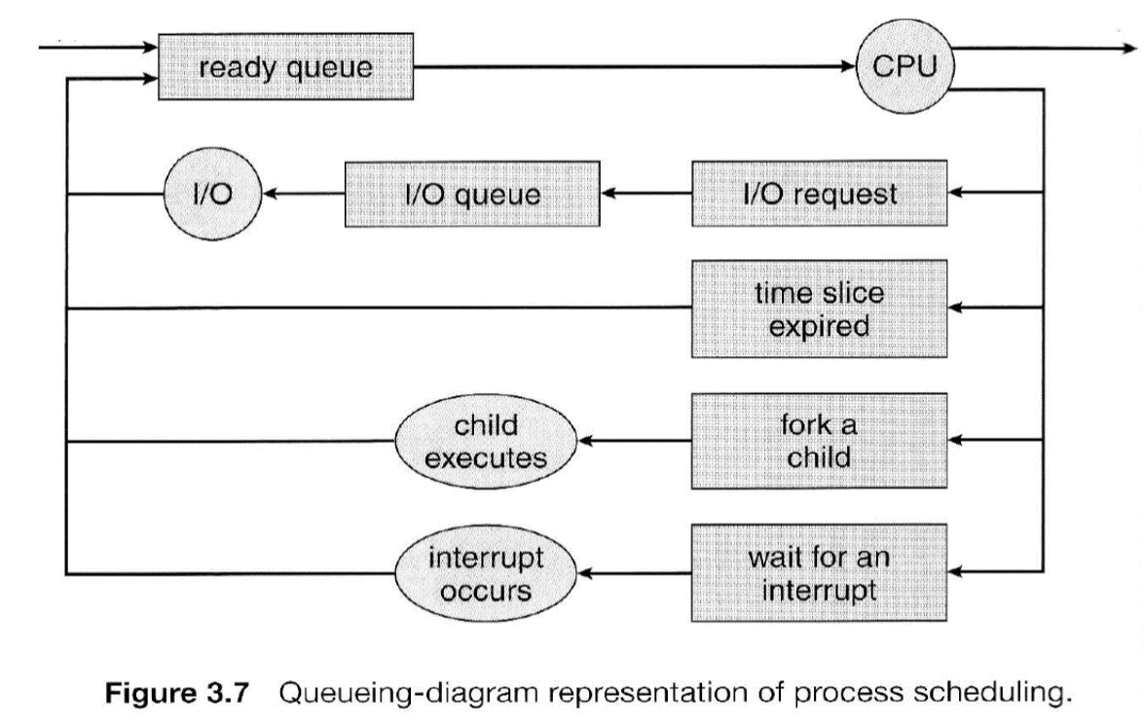
Queuing diagram representation of process scheduling

Slide 11
Goal of CPU scheduling
Maximize CPU utilization, Throughput, and fairness.
Minimize turnaround time, waiting time, and response time.

Slide 12
Deterministic Modeling
Process | Burst Time
P1 | 9
P2 | 33
P3 | 2
P4 | 5
P5 | 14
This evaluation method takes a predetermined workload and evaluates each algorithm using that workload.
Assume we are presented with the following processes, which all arrive at time zero

Slide 13
For FCFS the process would be executed in the following order, with the following wait times.
Therefore, the average waiting time is
=((0 + 9 + 42 + 44 + 49) / 5)
= 28.80 milliseconds
Process | Burst Time | Wait Time
P1 | 9 | 0
P2 | 33 | 9
P3 | 2 | 42
P4 | 5 | 44
P5 | 14 | 49

Slide 14
Scheduling algorithms

Slide 15
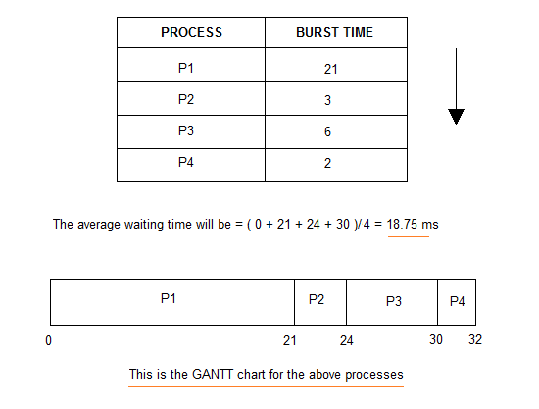
First Come First Serve(FCFS) Scheduling
Jobs are executed on first come, first serve basis.
Easy to understand and implement.
Poor in performance as average wait time is high

Slide 16
Shortest-Job-First(SJF) Scheduling
Preemptive Shortest Job First Scheduling, jobs are put into ready queue as they arrive, but as a process with short burst time arrives, the existing process is preempted.
Best approach to minimize waiting time.
Actual time taken by the process is already known to processor.

Slide 17
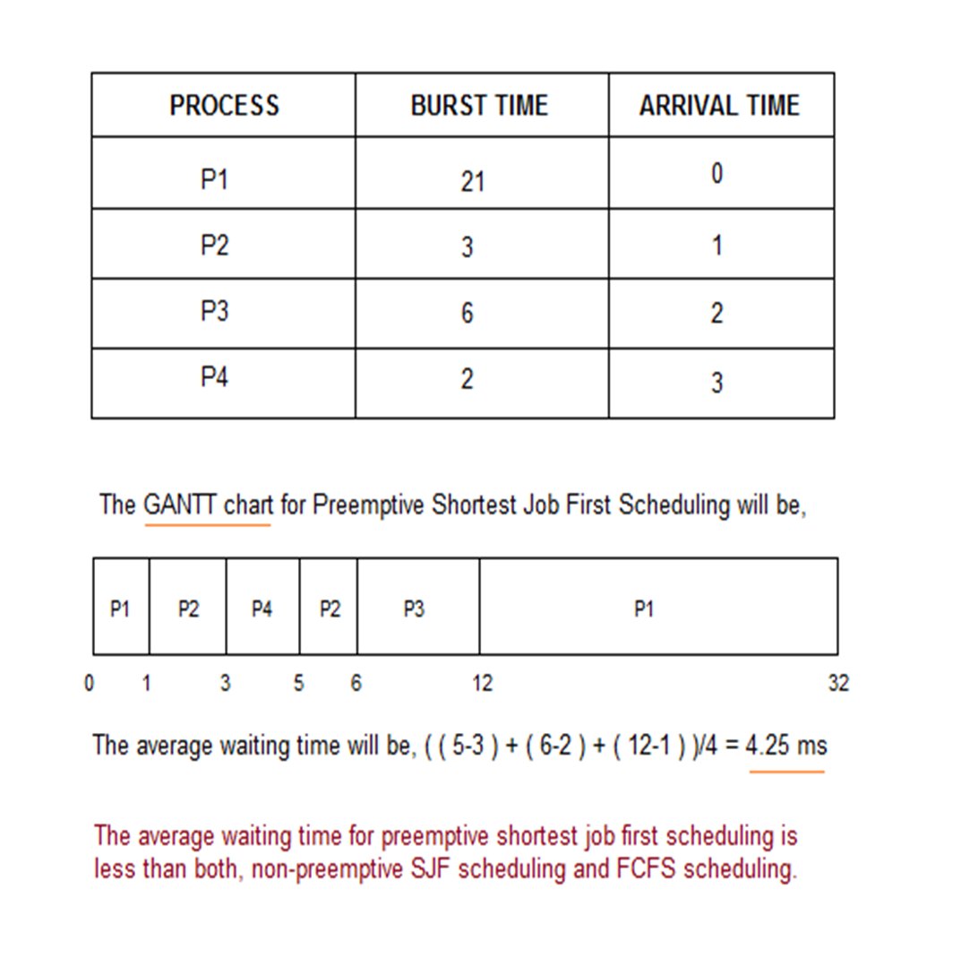

Slide 18
SHORT COMINGS OF SJF
Starvation: constant arrivals of short jobs can keep long ones from running.
There is no way to know the completion time of jobs (most of the time) Some solutions.

Slide 19
Priority Scheduling
Priority is assigned for each process.
Process with highest priority is executed first and so on.
Processes with same priority are executed in FCFS manner.
Priority can be decided based on memory requirements, time requirements or any other resource requirement.

Slide 20
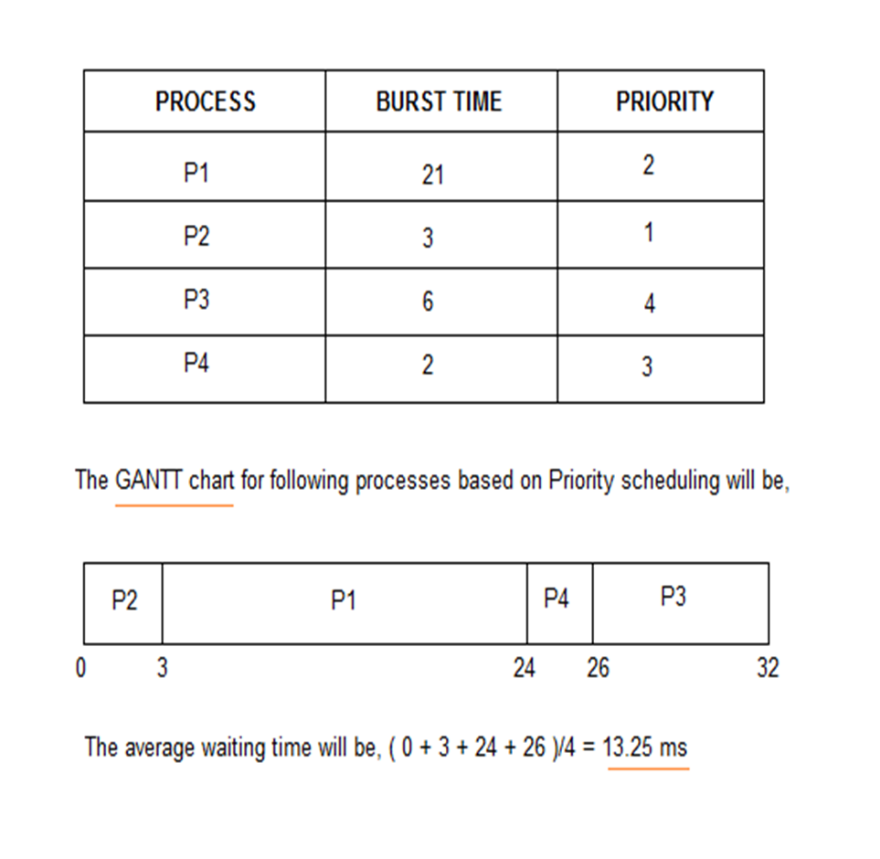

Slide 21
Round Robin scheduling
Round robin scheduling is similar to FCFS scheduling, except that CPU bursts are assigned with limits called time quantum.
When a process is given the CPU, a timer is set for whatever value has been set for a time quantum.
If the process finishes its burst before the time quantum timer expires, then it is swapped out of the CPU just like the normal FCFS algorithm.
If the timer goes off first, then the process is swapped out of the CPU and moved to the back end of the ready queue.
The ready queue is maintained as a circular queue, so when all processes have had a turn, then the scheduler gives the first process another turn, and so on.
RR scheduling can give the effect of all processors sharing the CPU equally, although the average wait time can be longer than with other scheduling algorithms.

Slide 22
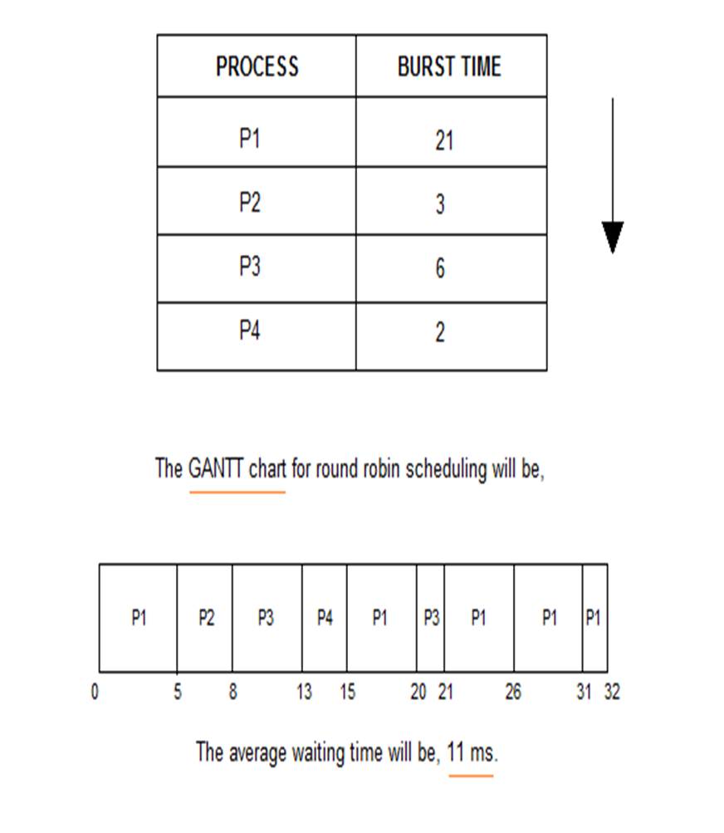

Slide 23
Draw a gantt chat and calculate the average waiting time for the following execution.
Process | Burst Time
P1 | 24
P2 | 3
P3 | 3

Slide 24
Multilevel Queue Scheduling
Multiple queues are maintained for processes.
Each queue can have its own scheduling algorithms.
Priorities are assigned to each queue.
In this kind of algorithm, jobs can not switch from one queue to the other.

Slide 25
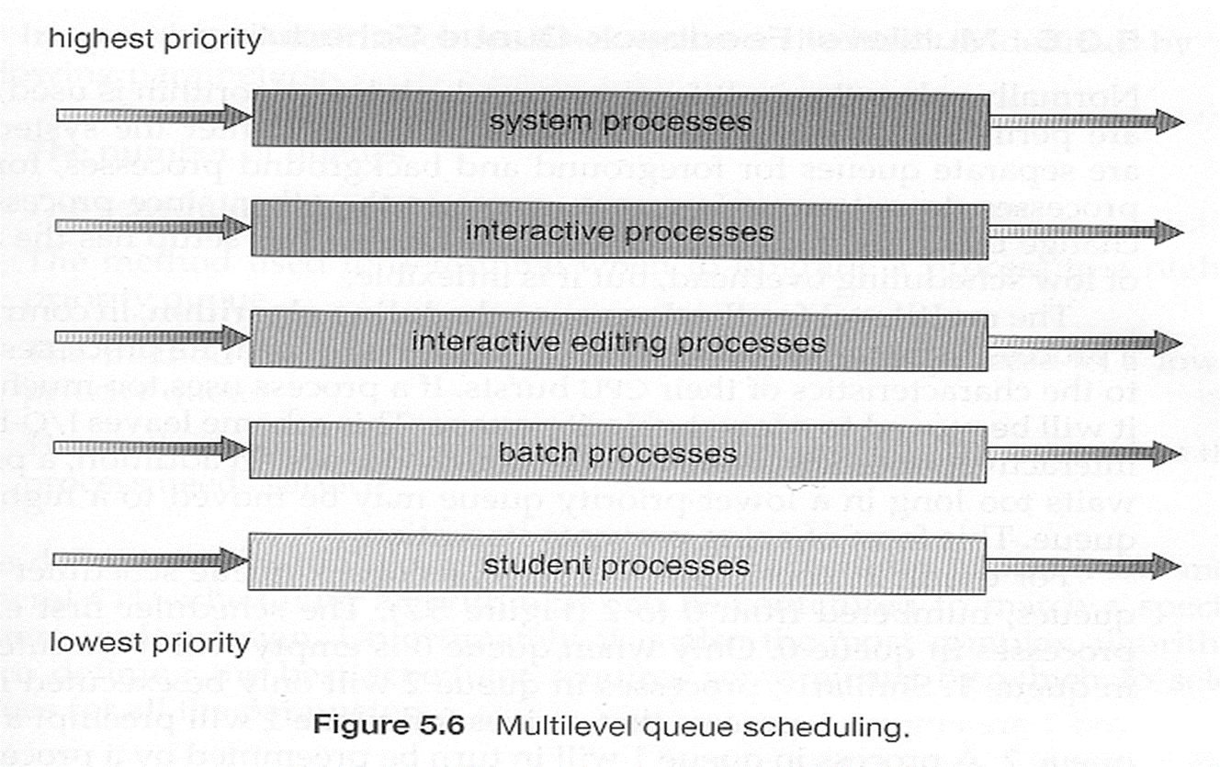

Slide 26
Multilevel Feedback-Queue Scheduling
Multilevel feedback queue scheduling is similar to the ordinary multilevel queue scheduling described above, except jobs may be moved from one queue to another for a variety of reasons:
If the characteristics of a job change between CPU-intensive and I/O intensive, then it may be appropriate to switch a job from one queue to another.
Aging can also be incorporated, so that a job that has waited for a long time can get bumped up into a higher priority queue for a while.

Slide 27
Multilevel feedback-queue scheduling cont;
Multilevel feedback queue scheduling is the most flexible, because it can be tuned for any situation. But it is also the most complex to implement because of all the adjustable parameters. Some of the parameters which define one of these systems include:
The number of queues.
The scheduling algorithm for each queue.
The methods used to upgrade or demote processes from one queue to another. ( Which may be different. )
The method used to determine which queue a process enters initially.

Slide 28
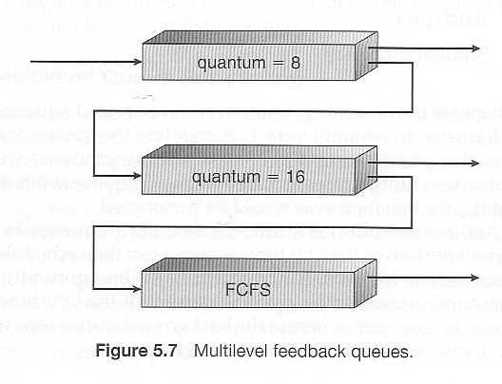

Slide 29
Thread Scheduling
The process scheduler schedules only the kernel threads.
User threads are mapped to kernel threads by the thread library - The OS ( and in particular the scheduler ) is unaware of them.
Pthread Scheduling
The Pthread library provides the platform for specifying scope contention:

Slide 30
Contention Scope
Contention scope refers to the scope in which threads compete for the use of physical CPUs.
On systems implementing many-to-one and many-to-many threads, Process Contention Scope, PCS, occurs, because competition occurs between threads that are part of the same process. ( This is the management / scheduling of multiple user threads on a single kernel thread, and is managed by the thread library. )
System Contention Scope, SCS, involves the system scheduler scheduling kernel threads to run on one or more CPUs. Systems implementing one-to-one threads ( XP, Solaris 9, Linux ), use only SCS.
PCS scheduling is typically done with priority, where the programmer can set and/or change the priority of threads created by his or her programs. Even time slicing is not guaranteed among threads of equal priority

Slide 31
Multiple-Processor Scheduling
When multiple processors are available, then the scheduling gets more complicated, because now there is more than one CPU which must be kept busy and in effective use at all times.
Load sharing revolves around balancing the load between multiple processors.
Multi-processor systems may be heterogeneous, ( different kinds of CPUs ), or homogenous, ( all the same kind of CPU ).
Even in the latter case there may be special scheduling constraints, such as devices which are connected via a private bus to only one of the CPUs.

Slide 32
Processor Affinity
Processors contain cache memory, which speeds up repeated accesses to the same memory locations.
If a process were to switch between processors each time it got a time slice, the data in the cache ( for that process ) would have to be invalidated and re-loaded from main memory, thereby removing the benefit of the cache.
SMP systems attempt to keep processes on the same processor, via processor affinity.
Soft affinity occurs when the system attempts to keep processes on the same processor but makes no guarantees.
Hard affinity, a process specifies that it is not to be moved between processors.
Main memory architecture can also affect process affinity, if particular CPUs have faster access to memory on the same chip or board than to other memory loaded elsewhere. ( Non-Uniform Memory Access, NUMA). )

Slide 33
Approaches to Multiple-Processor Scheduling
Asymmetric multiprocessing, in which one processor is the master, controlling all activities and running all kernel code, while the other runs only user code. This approach is relatively simple, as there is no need to share critical system data.
Symmetric multiprocessing, SMP, where each processor schedules its own jobs, either from a common ready queue or from separate ready queues for each processor.
Virtually all modern OSs support SMP.

Slide 34
